Slide 1
Scheduler
Dipen Patel – Scrum Master
Shalin Banjara – Team Member
Sanket Patel – Team Member
Devraj Valecha – Team Member
Ruby Verma – Team Member
Sonny Kr – Team Member

Slide 2

Scheduler
Scheduler Mobile App
Scheduler Web Application
Agenda
Roles and Responsibilities
Project Overview
Project Background
Problem Statement
High Level Architecture Diagram
Deliverables
Solution
Issues Encountered
Appointment Booking System
Notifications and Announcements
Burn Down Chart
Epics
Project Architecture
Questions and Answers
Project Walkthrough
Roles
Work Break Down Structure
Scheduler Web Application
Scheduler Mobile Application
Technologies used
Prioritization Stories
Link to our pivotal tracker project :-
https://www.pivotaltracker.com/s/projects/909496

Slide 3
Scheduler
Scheduler Mobile App
Scheduler Web Application
Dipen Patel – Scrum Master
Pivotal Tracker
Shalin Banjara - Developer
Web Features of 23 points
Documentation
Sanket Patet - Developer
Web Features of 16 points
Documentation
Devraj Valecha – Developer
Ruby Verma – Developer
Sonny Kr – Developer
Documentation
Documentation
Documentation
Web Features of 15 points
Web Features of 12 points
Web Features of 17 points
Documentation
Project Management
Mobile Features of 2 points
Mobile Features of 6 points
Mobile Features of 2 points
Mobile Features of 6 points
Mobile Features of 5 points
Chores
Release Stories
Bugs
Epics
Feature Allocations
Chore Allocations
Bug Allocations
Time Management
Document Allocations
Roles and Work Break Down Structure
14 Epics
14 Chores
108 Feature Points
Link to our pivotal tracker project :-
https://www.pivotaltracker.com/s/projects/909496

Slide 4



Scheduler
Scheduler Mobile App
Scheduler Web Application
Project Background
Very long queue ups in front of Government organizations and places like college enrolment department is a normal scene even in this 21st century, even when people uses computers and internet to do each and everything.

Slide 5
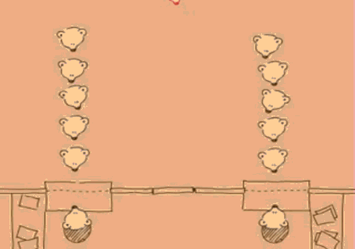
Scheduler
Scheduler Mobile App
Scheduler Web Application
Problem Statement
Even after standing in such long queues to schedule an appointment, people has to wait hours to meet the counsellor, hoping to call their name to be called out. As students of the technology department of Centennial College, we would like to make proper implementation of technology to solve this problem.

Slide 6
Scheduler
Scheduler Mobile App
Scheduler Web Application
Technologies Used in Development
Java Spring
Android
Java Script
MySQL
Google Cloud Messaging service
Java Server Pages
JQuery
Ajax
Bootstrap
Link to our pivotal tracker project :-
https://www.pivotaltracker.com/s/projects/909496

Slide 7
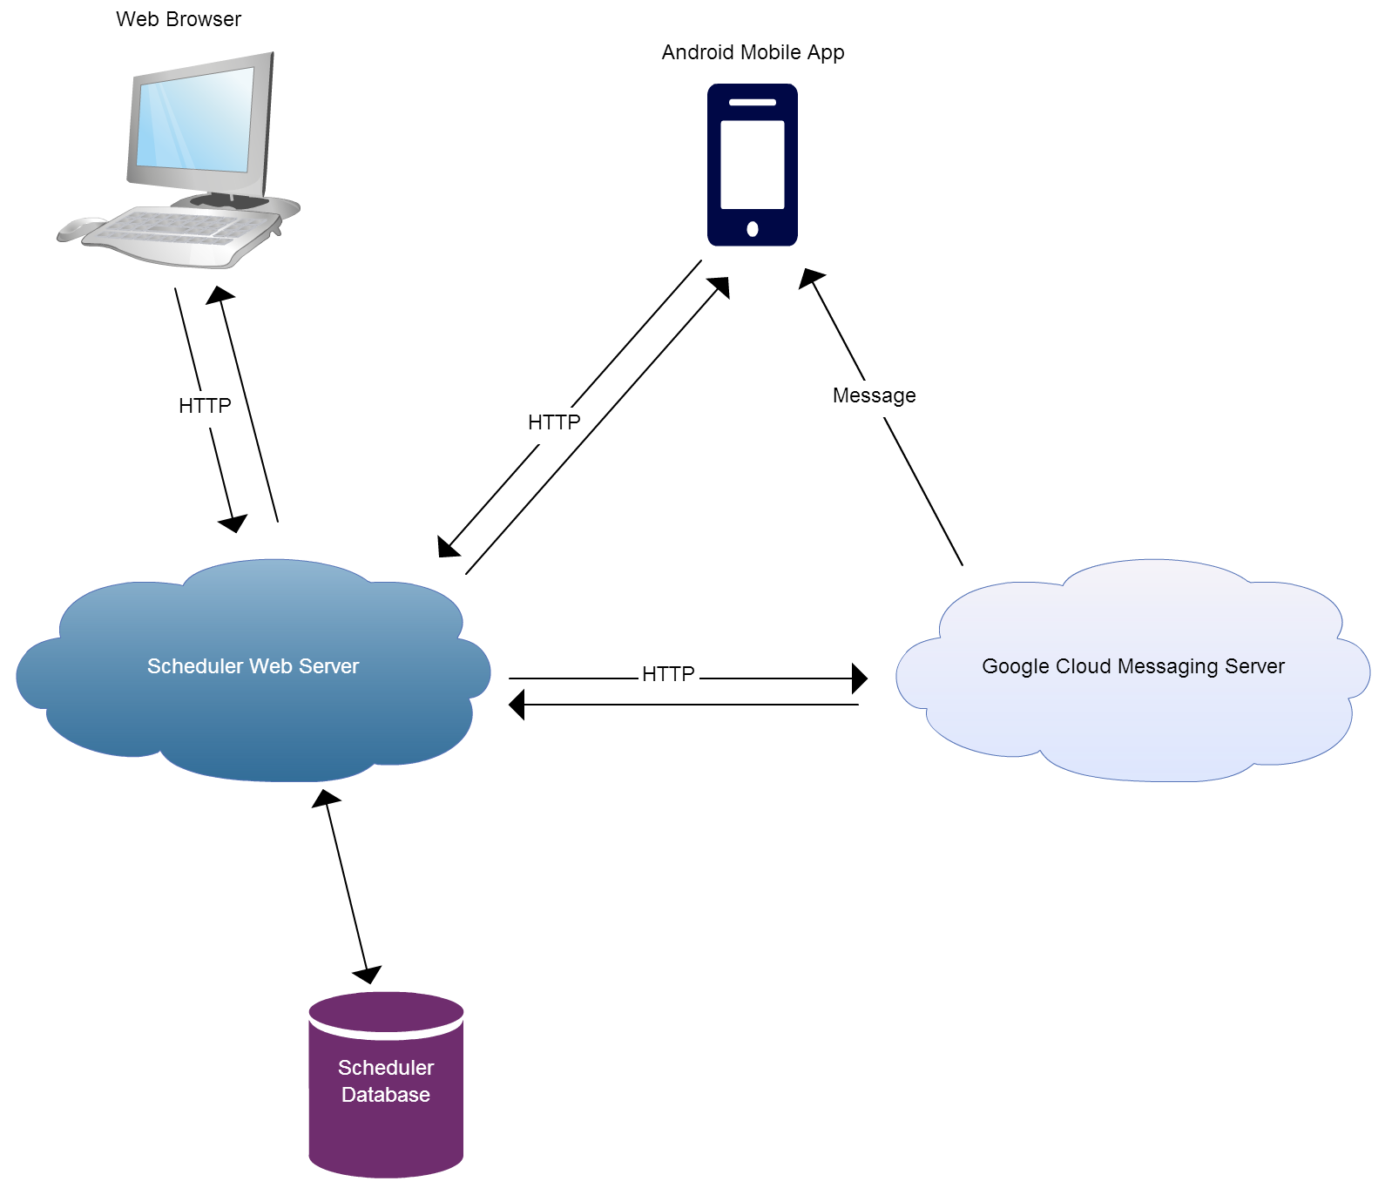
Scheduler
Scheduler Mobile App
Scheduler Web Application
High Level Architecture Diagram

Slide 8
Scheduler
Scheduler Mobile App
Scheduler Web Application
Project Architecture
Scheduler Web Application
View
src->main->webapp->WEB-INF->views-> jsp files
Control
com.scheduler.controllers
Model
com.scheduler.services
Persistence
com.scheduler.mappers
src->main->webapp->WEB-INF->classes->mappers
src->main->webapp->resources->css and js files
com.scheduler.models
Scheduler schema
Scheduler Mobile App
Database
View
res->layout->xml files
Control
com.schedulerapp.activities
Model
com.schedulerapp.models
com.schedulerapp.tasks

Slide 9
Scheduler
Scheduler Mobile App
Scheduler Web Application
Deliverables
Applications
Developer’s Manual
Admin Manual
Documents
Scheduler Web Application
Scheduler Mobile Application
User’s Manual
Link to our pivotal tracker project :-
https://www.pivotaltracker.com/s/projects/909496

Slide 10
Scheduler
Scheduler Mobile App
Scheduler Web Application
Issues Encountered
Use of New Technologies
Integration
Unit Testing
Scope of the Project
Dependency
Time Management
Coding Standards
Link to our pivotal tracker project :-
https://www.pivotaltracker.com/s/projects/909496

Slide 11
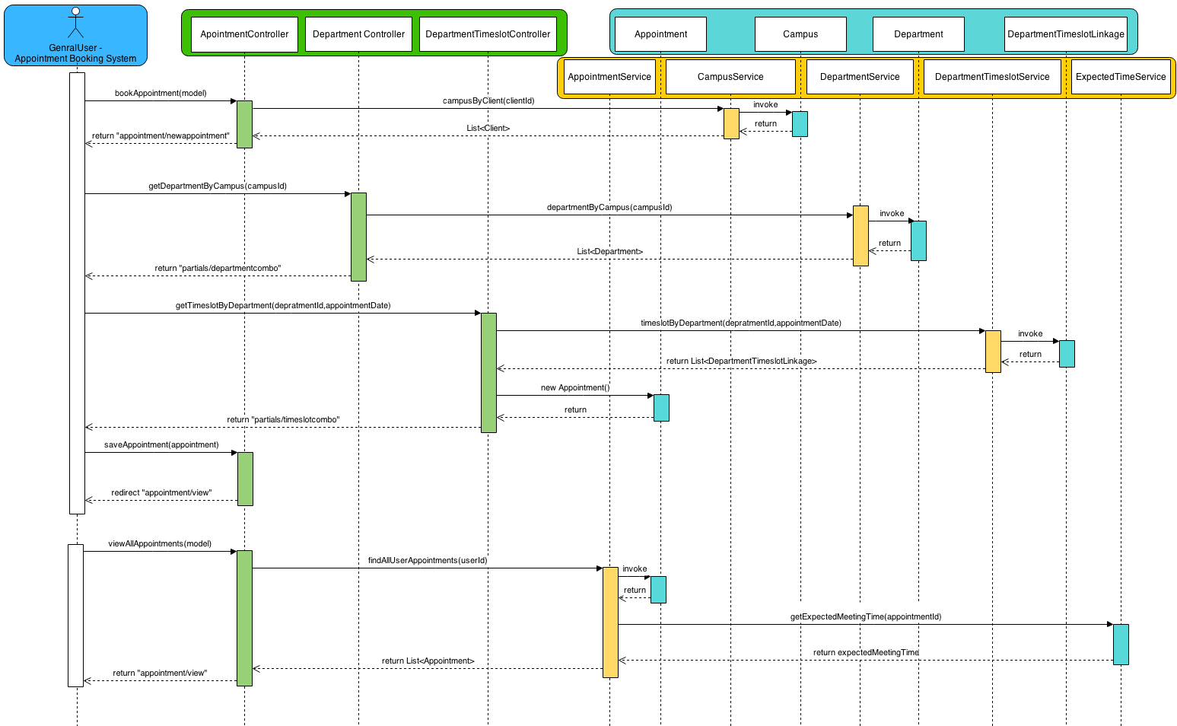
Scheduler
Scheduler Mobile App
Scheduler Web Application
Appointment Booking System

Slide 12
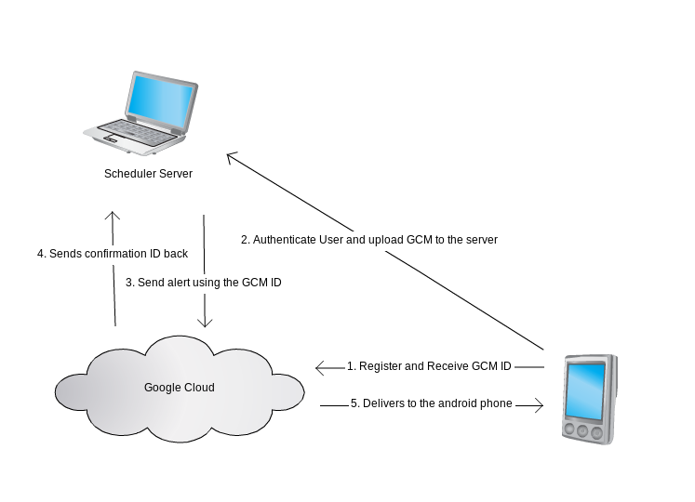
Scheduler
Scheduler Mobile App
Scheduler Web Application
Announcements and Notifications System

Slide 13
Scheduler
Scheduler Mobile App
Scheduler Web Application
Prioritization Stories
Based on core functionalities
Registration Process
Based on Priority
Based on complexity
Based on dependency
Booking an appointment
Starting an appointment
Finishing an appointment
Generating appointment Queue
Dynamic UI for booking an appointment
Calculating Expected Meeting Time
Sending Notification
Pushing notifications of User’s android device
Calculating available timeslots based on days and capacity
Booking appointment from mobile devices
Pulling Notifications and Announcements on mobile devices
CRUD operations
Login Functionality
Create Department
Link to our pivotal tracker project :-
https://www.pivotaltracker.com/s/projects/909496

Slide 14
Scheduler
Scheduler Mobile App
Scheduler Web Application
Epics
Epics were created based on modular functionality that represents significant feature.
Book Appointment (Web)
Book Appointment (Mobile)
Meeting Official (Web)
Client On boarding(Web)
FAQs[mobile]
FAQs[web]
Authentication
Link to our pivotal tracker project :-
https://www.pivotaltracker.com/s/projects/909496

Slide 15
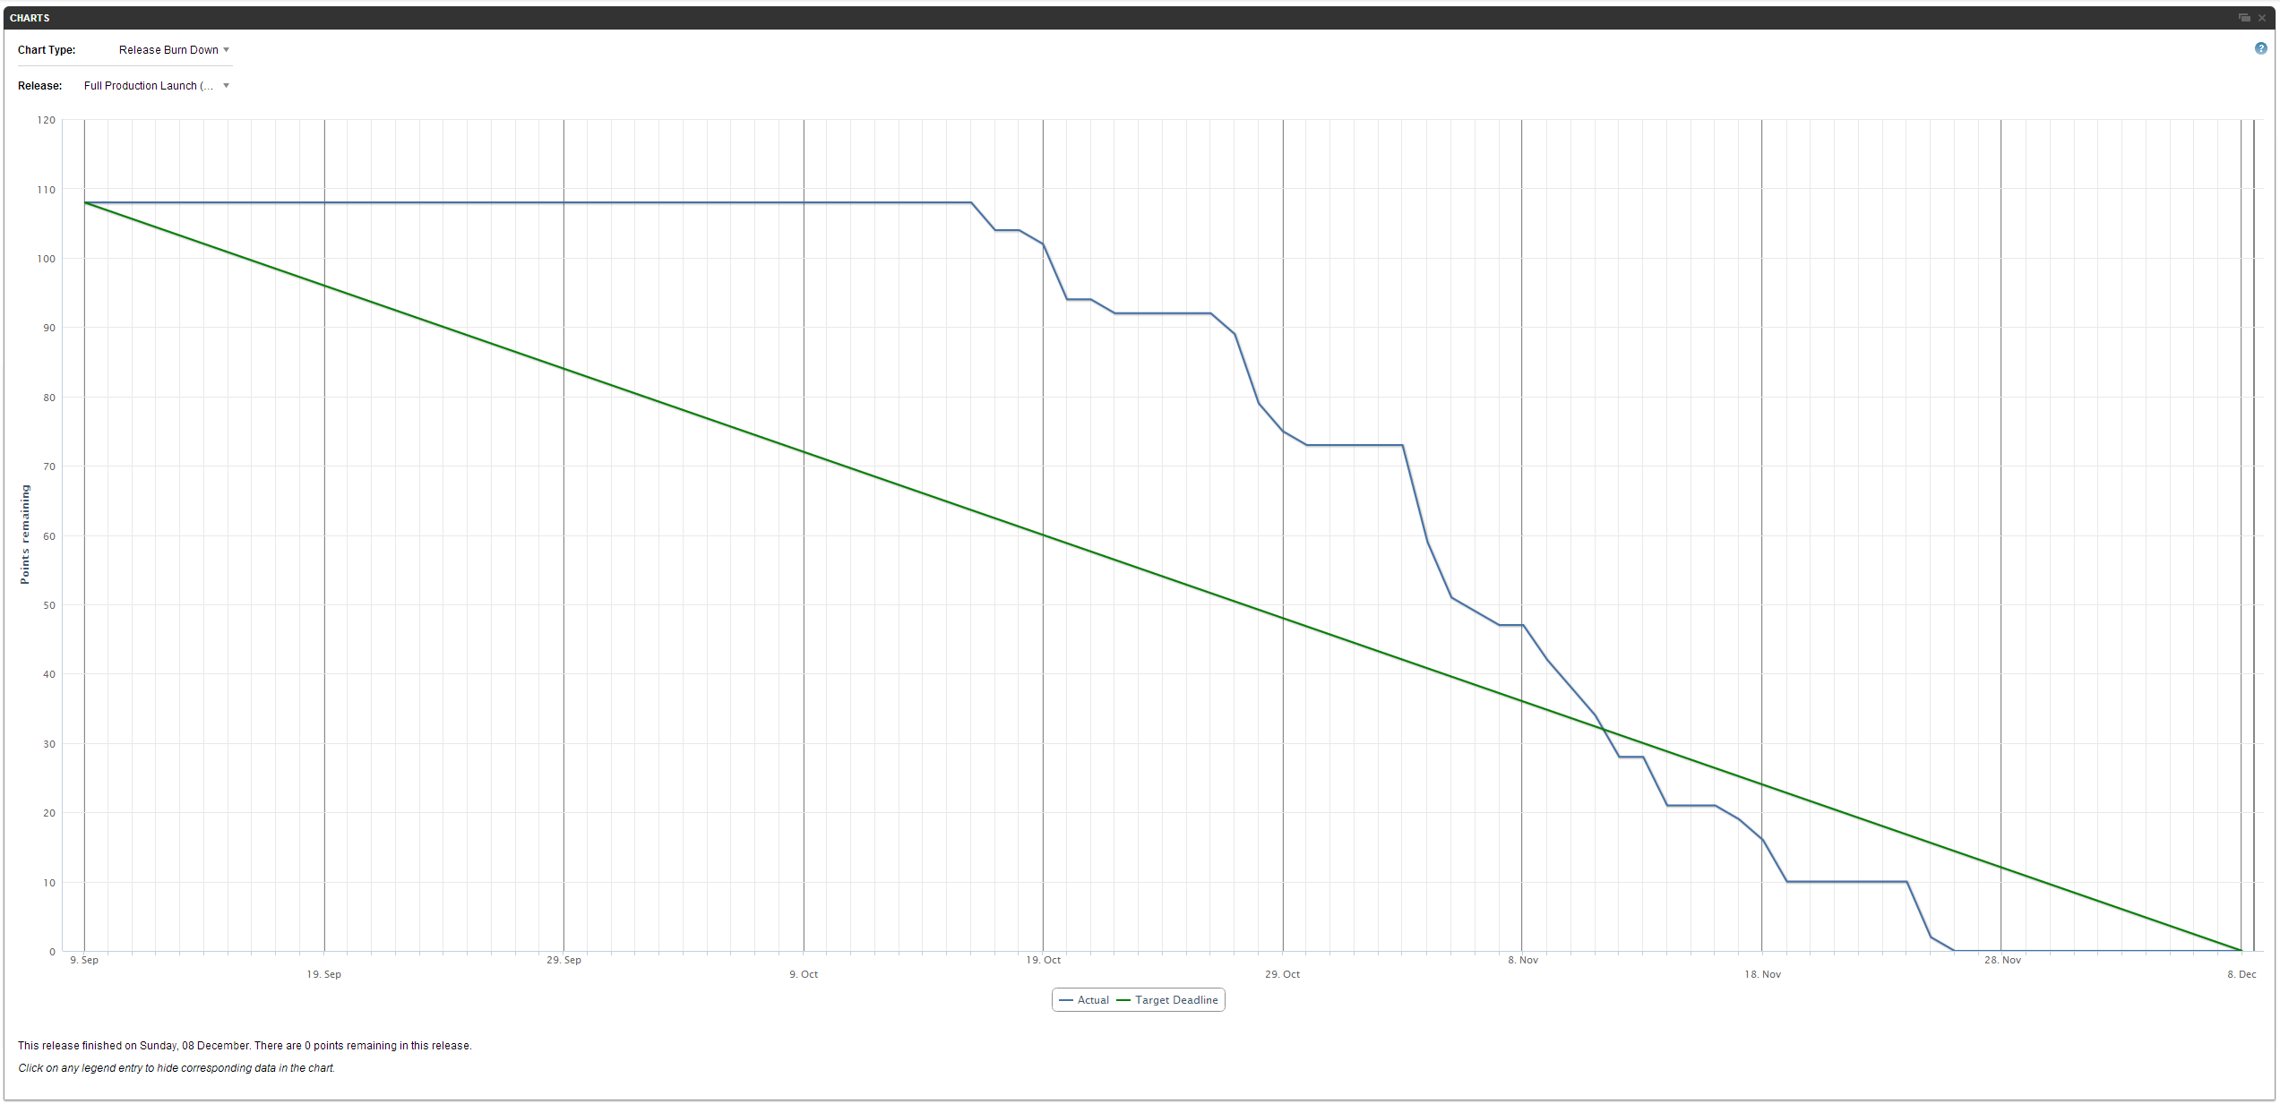
Scheduler
Scheduler Mobile App
Scheduler Web Application
Release Burn down Chart
Link to our pivotal tracker project :-
https://www.pivotaltracker.com/s/projects/909496

Slide 16
Scheduler
Scheduler Mobile App
Scheduler Web Application
Project Walk-Through
Scheduler Web Application
Scheduler Mobile Application
Link to our pivotal tracker project :-
https://www.pivotaltracker.com/s/projects/909496

Slide 17






Questions

